Slide 1
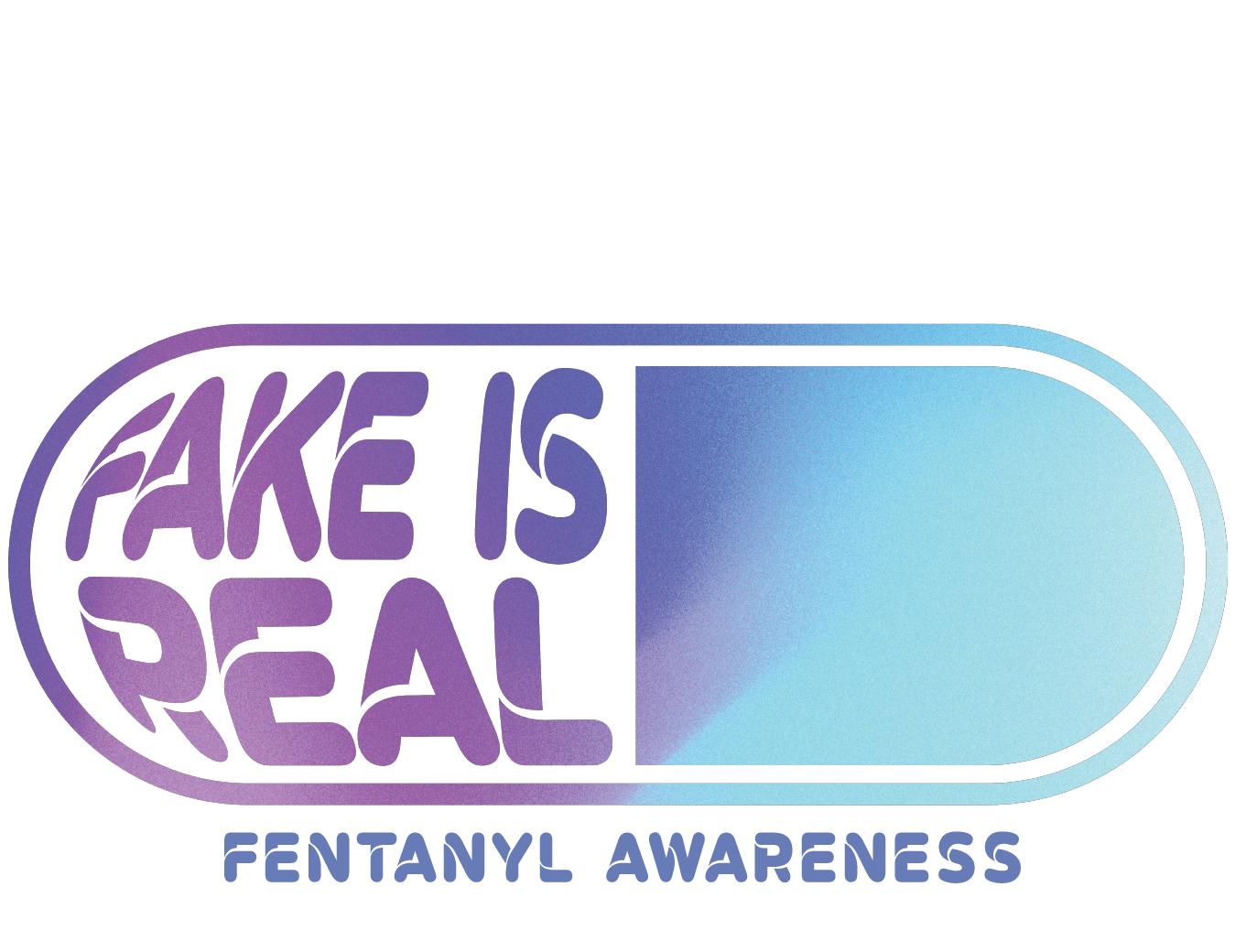
Fake Is Real is a fentanyl awareness campaign brought to you by the County of Northampton.
Real Help Against Fake Pills.

Slide 2
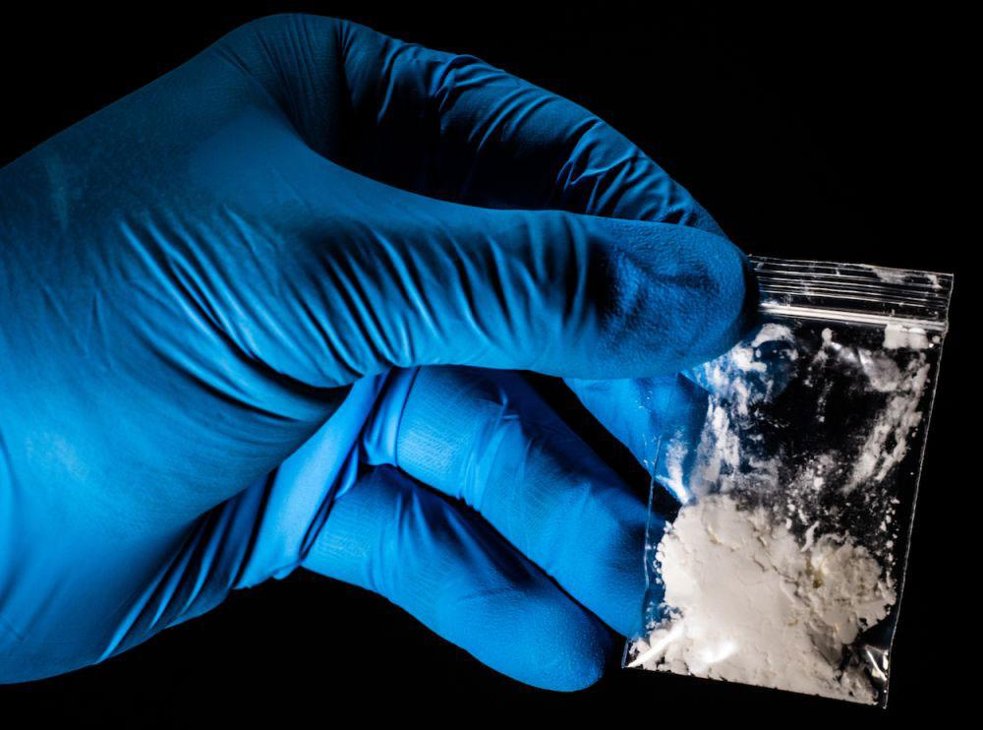
Fentanyl is a powerful synthetic (lab created) opioid (pain-killer), or narcotic (a type of drug), that is similar to morphine, medicine prescribed by doctors for severe pain.
Fentanyl is 50 to 100 times stronger than heroin and is fatal at very small dose.
What is Fentanyl?

Slide 3
Fake pills are made and sold to mimic real ones. They are pressed and can contain fatal drugs like fentanyl. There is no easy way of telling what your pill contains. There is no color, taste or smell associated with fentanyl.
These fake pills are ones that are bought online, on social media or on the streets. This does NOT include pills prescribed by your doctor.
What are ‘Fake Pills’?

Slide 4
Dealers are using Fentanyl in fake pills because:
It is much cheaper to make than other opioids
It is highly addictive, making people want more
They do not care who dies
Why are ‘Fake Pills’ Made?

Slide 5
Why Would Someone Take Pills?

Slide 6
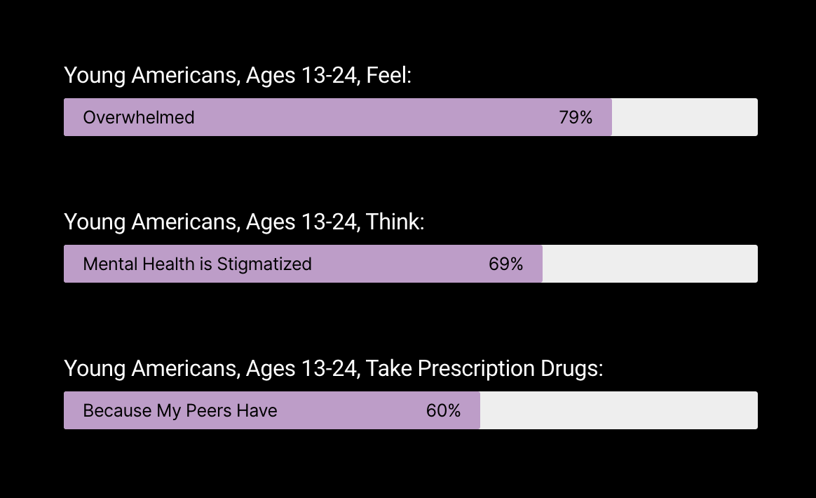
• Feeling Overwhelmed 79%
• Stigmatize Mental Health 69%
• Feeling Pressured 42%
Why Would Someone Take Pills?
Stress & Behavior Among Youth
Top Stressors
Academic, Social, Financial & Future

Slide 7
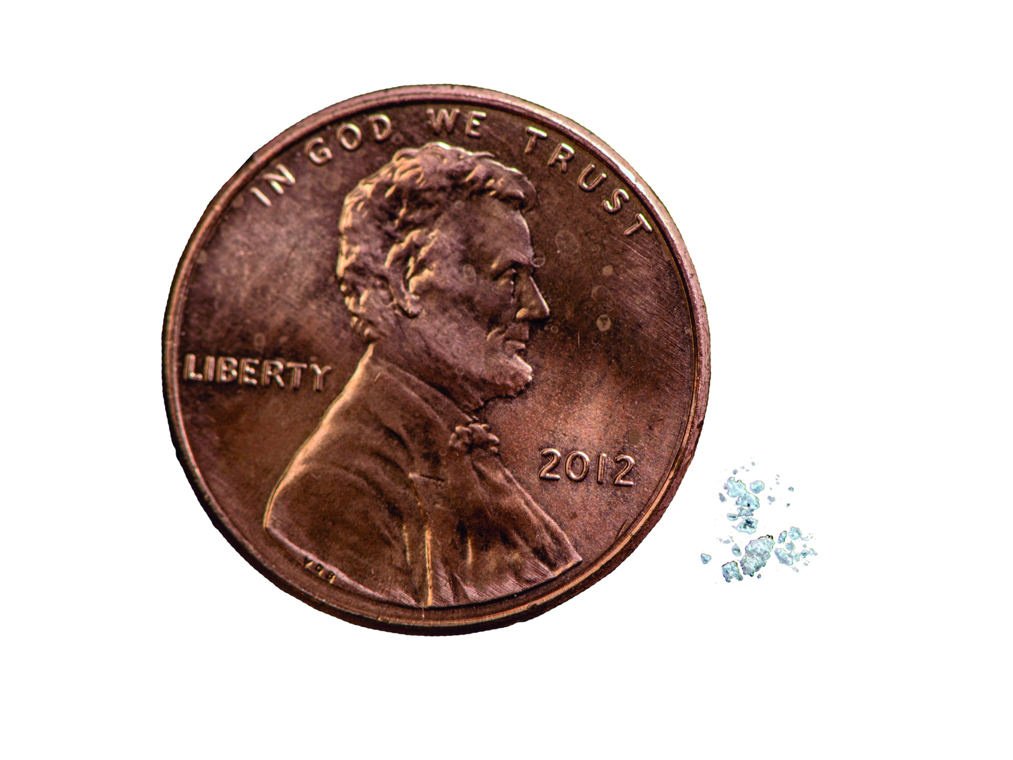
In a typical 30 mg pill–it only takes 2 mg of fentanyl for a lethal dose. That’s about the size of a few grains of sand.
64% of Teens are unaware that fentanyl is being used to create fake pills.
7 out of 10 Pills bought on the streets contain lethal doses of fentanyl.
Small Dose. Huge Risk.

Slide 8
Which is Fake?
Which is Real?

Slide 9
See the difference
REAL
FAKE

Slide 10
Which is Fake?
Which is Real?

Slide 11
See the difference
FAKE
REAL

Slide 12
Overdose & Poisoning
What’s the Difference?
Drug Overdose
Is taking too much of a substance, whether it’s prescription, over-the-counter, legal, or illegal. Drug overdoses may be accidental or intentional.
Fentanyl Poisoning
Unknowingly taking fentanyl laced drugs while under the assumption that you are taking the real thing. Fentanyl poisonings are accidental.
Notes:
TEACHER EXPLAINS THESE TOPICS TO CLASS.

Slide 13
*
There is no easy way of telling what the pill contains. There is no color, taste or smell associated with fentanyl.

Slide 14
In Class Activity
Notes:
Print out the next 4 slides. Which is Fake? Which is Real?

Slide 15
In Class Activity
The Chocolate Chip Cookie Effect A game where trying to separate ingredients is impossible.
Materials
Choose one of
the following
Overview of Activity
Step 1: Each table gets two colors of material. Divide colors among the students at the table
Step 2: First student mixes both colors and passes the “ball” to the next student to mix their two colors
Step 3: The remaining students in the group try to separate the colors to make them not mixed anymore
Kinetic Sand
Playdough
Model Magic
Slime
Notes:
Materials Needed:
Bean Boozled Order here
Print out color square sheets
Wheel to spin

Slide 16
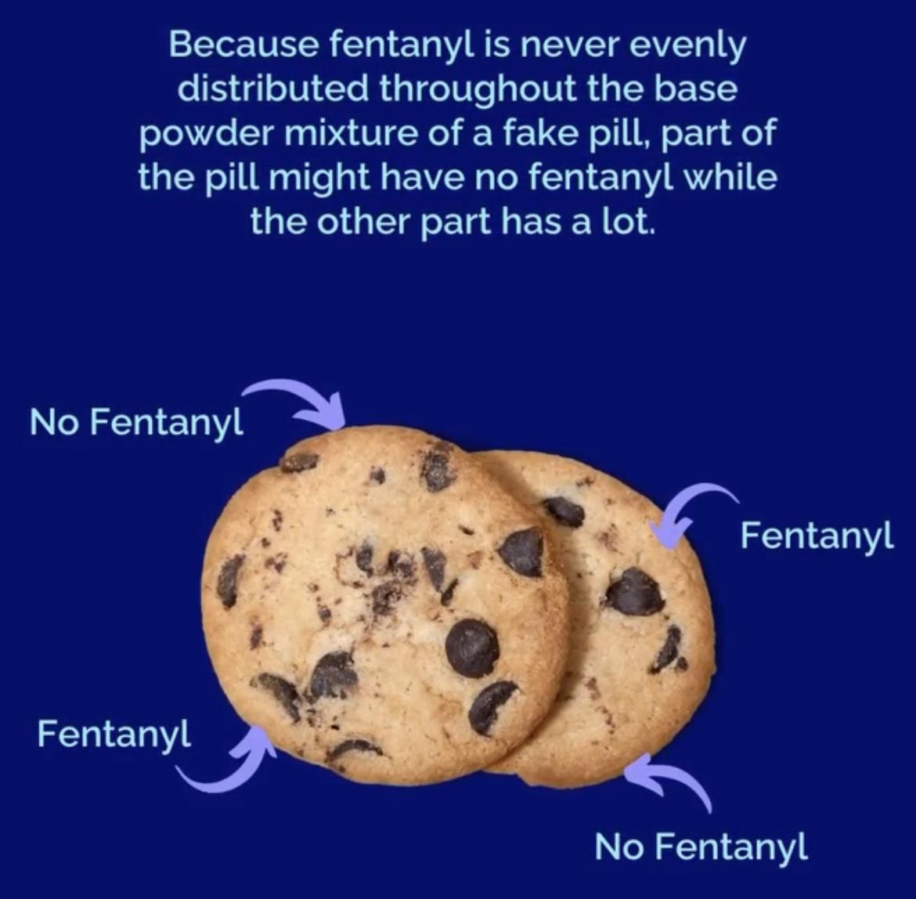
The Chocolate Chip Cookie Effect
Think of it this way–Cookie batter doesn’t distribute chocolate chips equally within the cookie. The same is true for a fake pills–fentanyl may be in some pills from the same batch and not in others. In other words, fentanyl is like the "chocolate chips" in cookies. The chocolate chips are randomly spaced and could be clustered in one area, depending on which cookie you get.
Notes:
TEACHER EXPLAINS THESE TOPICS TO CLASS.

Slide 17
Scenario 1
It’s a saturday night and you are going to hang out with a group of friends. Your one friend thinks in order to have “fun” and “relax”, they need to take drugs.
You want to have fun with your friend, but not in that way. On the way to hang out, you talk to the friend.
What do you say?

Slide 18
Scenario 2
What are healthy ways to cope with stress?
You are dealing with a lot of pressure from your parents, coaches and/or teachers. You are feeling very overwhelmed between school work, sports and things at home. You are looking for a way to numb your stress, so you were thinking about escaping with pills.

Slide 19
Scenario 3
How do you handle the situation?
You are at a friday night football game. You meet up with a group of friends and they talk about taking pills they got from their friend’s brother. They give you one and tell you to take it with them or else they won’t hang out with you. You know it could be dangerous and don’t want to take it…

Slide 20
Scenario 4
If you want to talk about things like this, who are people you can talk to?
Some of your friends told you that they started sneaking their parents medications and it makes them feel high. They tell you to try it. You are curious and find some pills in your grandparent’s cabinet…

Slide 21
Scenario 5
What do you do?
You are hanging out with your friends and everyone has taken some pills. One of your friends passes out and is not responding. You think they might be overdosing…

Slide 22
How to Help

Slide 23
Immediate blue
or grey lips
Confusion before
becoming unresponsive
Foaming at
the mouth
Body stiffening/seizure
like activity
Know the Signs of Fentanyl Poisoning

Slide 24
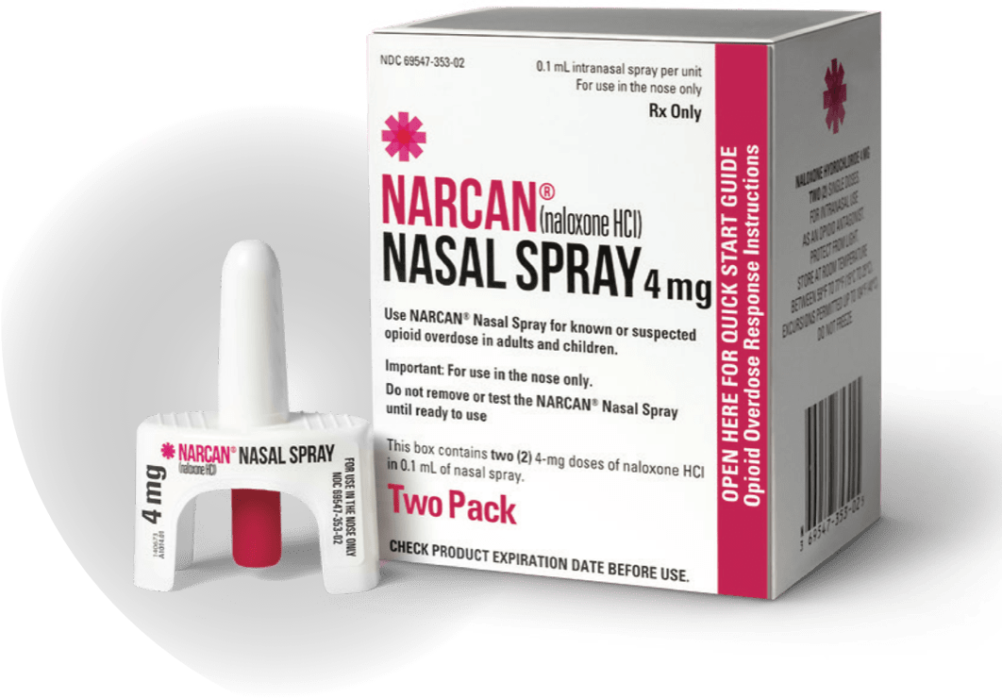
If you are ever in this situation, don’t run.
Call 911 and use NARCAN. You can help save a life.
NARCAN is a nose spray that can be given to a person to reverse a fentanyl poisoning by stopping the effects of opioids. NARCAN is a safe, easy-to-use, live-saving medication.
Multiple doses might be necessary because of how strong fentanyl can be. Multiple doses will not hurt the person.
Be Prepared. Don’t Panic!

Slide 25
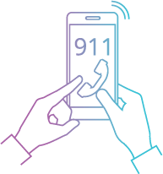
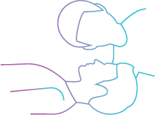
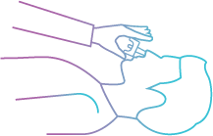
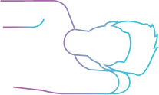
Once you identify an overdose and administer NARCAN
3. Insert nozzle of NARCAN into nose and press the plunger.
1..Call 9-1-1 immediately!
2. Lie them on their back and tilt their head back.
4. Turn them on their side with one knee bent and hands under head for support.
5. Stay with them until help arrives. If they still are not breathing or responding after a few minutes, give them a second dose.
You Can Save A Life!

Slide 26
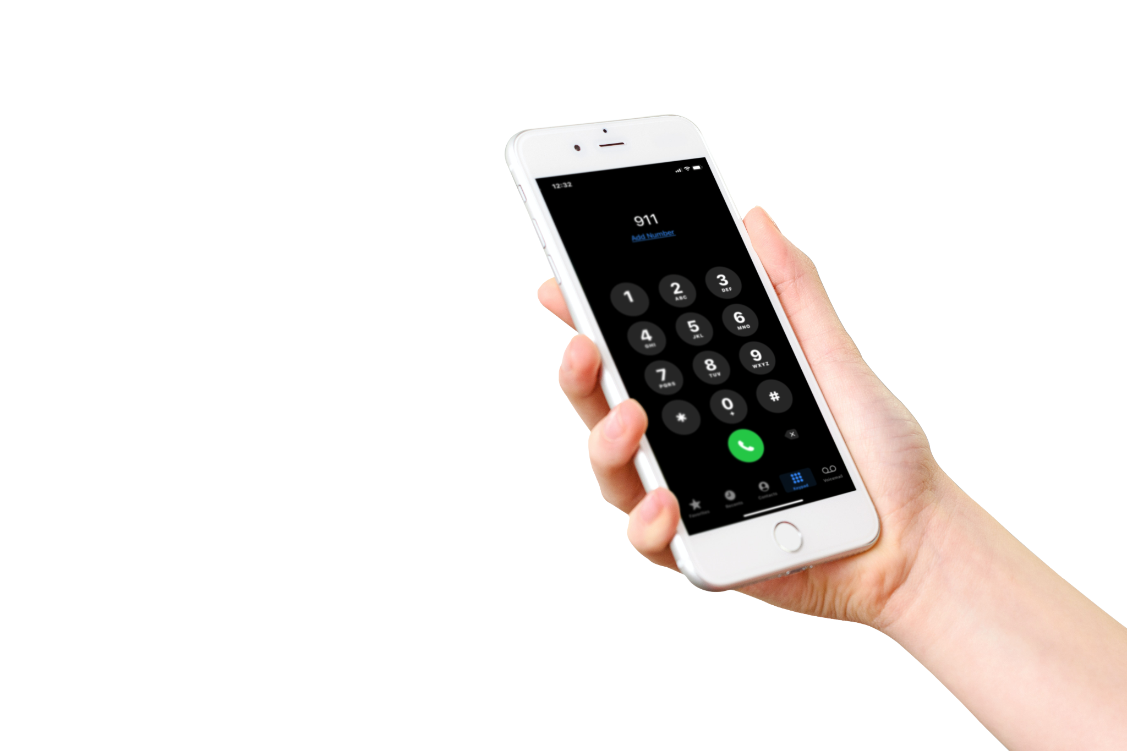
Even if you took a pill or were using drugs too, you will not be arrested. It’s important that you don’t panic, get help and save a life.
Under the law, you will be granted certain criminal and civil protections under Act 139 even if you’re using drugs. If you’re with someone who is experiencing an overdose call for help and save their life.
Save A Life!

Slide 27
Do you know someone who has been affected by fentanyl poisoning?

Slide 28
For more information and resources, Visit FAKEISREAL.ORG.
610-829-HELP

